Slide 1
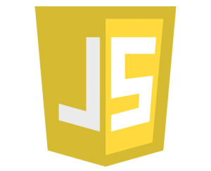
Introduction to Javascript
Rufo n. gabrillo jr.

Slide 2

Javascript Origins
A 22-year-old programming language that is mainly used on the web. Allows dynamic interaction and effects to happen based on conditions and events.

Slide 3
History of Javascript
May 1995
JavaScript, not to be confused with Java, was created in May 10, 1995 by Brendan Eich, then working at Netscape and now of Mozilla.
JavaScript was not always known as JavaScript: the original name was Mocha, a name chosen by Marc Andreessen, founder of Netscape.

Slide 4
History of Javascript
September 1995
In September of 1995 the name was changed to LiveScript, then in December of the same year, upon receiving a trademark license from Sun, the name JavaScript was adopted. This was somewhat of a marketing move at the time, with Java being very popular around then.

Slide 5
History of Javascript
1996 - 1997
In 1996 - 1997 JavaScript was taken to ECMA to carve out a standard specification, which other browser vendors could then implement based on the work done at Netscape.
The work done over this period of time eventually led to the official release of ECMA-262 Ed.1: ECMAScript is the name of the official standard, with JavaScript being the most well known of the implementations.

Slide 6
History of Javascript
Microsoft
Over time it was clear though that Microsoft had no intention of cooperating or implementing proper JS in IE, even though they had no competing proposal and they had a partial (and diverged at this point) implementation on the .NET server side
While all of this was happening the open source and developer communities set to work to revolutionize what could be done with JavaScript.

Slide 7
History of Javascript
2005
This community effort was sparked in 2005 when Jesse James Garrett released a white paper in which he coined the term Ajax, and described a set of technologies, of which JavaScript was the backbone, used to create web applications where data can be loaded in the background, avoiding the need for full page reloads and resulting in more dynamic applications.
This resulted in a renaissance period of JavaScript usage spearheaded by open source libraries and the communities that formed around them, with libraries such as Prototype, jQuery, Dojo and Mootools and others being released.

Slide 8

Now let’s start coding!

Slide 9
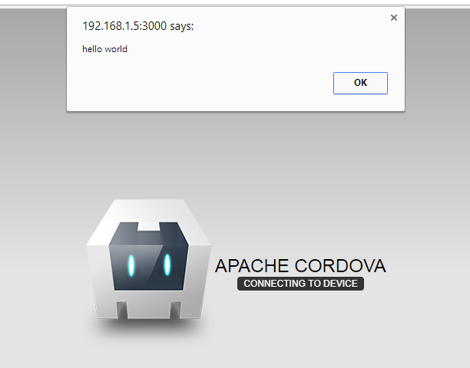
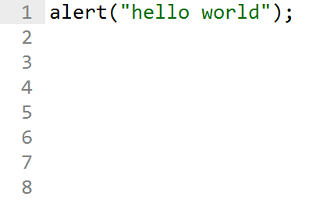
Alert
This time I will use the alert because it is much easier to get started with rather than using the browser’s console. There’s no need to open the developer tools which takes time to familiarize.

Slide 10
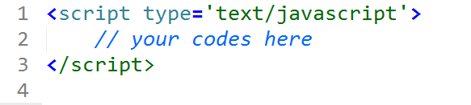
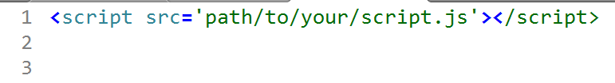
Adding script
You have 2 options when you want to add your script. First, you can add your code inline, within the script tag.
Or you can create an external Javascript file with a *.js file and load it in <script> tag.
Note: You have to close the <script> tag. Even though there is nothing on it, it is not a self-closing tag. Within your javascript file, you are free to add your js program.

Slide 11
Where to put your script?
Within a typical HTML file, there are typically two places people use to load their external JS files. The first is within the head, and the second is just before the closing </body> tag. In the past, scripts were always loaded into the head element, but with performance and page loading speeds more critical than ever, it’s often recommended to place your scripts at the bottom of your page. This is an approach I side with, too.
The browser renders the page from top to bottom, and when it comes across your scripts, it pauses rendering the page to load in your JS. Thus, the page loads slower (or, more importantly, feels that way to the user) because the rendering is blocked by your loading JavaScript files. Hence, putting the scripts just before the closing </body> tag means that when the time comes to load your scripts, the rest of the page has been loaded.

Slide 12
Take note
Before moving on to looking at the language itself, there’s one more thing I’d like to note. If you’re using the new HTML5 doctype (<!DOCTYPE html>) rather than one of its more long-winded predecessors, you don’t actually need to define the type attribute on your script tags. Simply,
<script src="path/to/your/file.js"></script>
is enough. This does not cause issues in older browsers—neither does the HTML5 doctype—and I highly recommend using it.

Slide 13
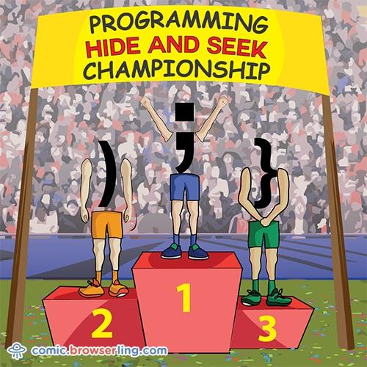
Syntax Conventions
JavaScript’s syntax is pretty basic and clear, but there are certain subtleties that you will discover on the way. There’s often more than one way to do things, but the community has certain conventions that have stuck over time. One convention that I want to mention straightaway is semicolons. Often in JavaScript,
adding a semicolon at the end of a line is optional, and you will see tutorials that don’t do it. However, the convention is to always use a semicolon at the end of a line, and that’s what I’ll be following here. There are obviously certain circumstances when you can’t use one, and you will see those, but in any situation where a semicolon is optional, I’ll use one.
I recommend you do, too.

Slide 14
Syntax Conventions
Another consideration to make is for white space. It is insignificant in JavaScript, so you can layout code the way you like in terms of white space. Whenever you are inside a set of braces, you should indent by one tab, but other than that, you will find yourself adapting your own standard.

Slide 15
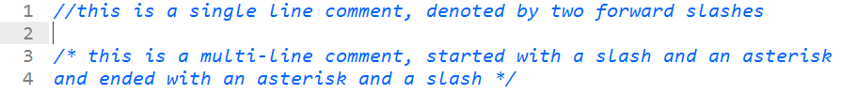
Comments
Before continuing, at this stage it’s worth discussing comments. JavaScript allows us to insert comments. This is content that will be ignored and not treated as code, so you can put anything you want in them. It’s useful for documenting your code. There are two syntaxes for comments—one for a single line comment and one for a multiline comment:
Use these when you like to remind yourself about a piece of code and what it does, or to provide references for the future you. After not working on code for a long period of time, comments can really help you remember why you wrote what you wrote.

Slide 16
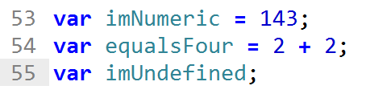
Variables
Often when coding, we want to save the state of something. Perhaps we want to remember that the current colour of our background is red, or the calculation we just performed totalled 33.
JavaScript, like most languages, has variables: a place to store information. To create one, you simply declare it with the var keyword, name it, and then set it to equal to something.
You can also declare a variable without explicitly setting its value. If you do this, the variable will be set to undefined, a special value in JavaScript that simply means that this variable has not been set to anything.

Slide 17
Variables
Numeric
Here, I declared a variable imNumeric that has a 143 value. The second is set to 2 + 2. Here, you meet the plus (+) operator, one of JavaScript's many operators. The third is a variable that doesn’t have a value. It is set to undefined.
Variables can contain letters, numbers and underscores. They cannot start with numbers.
So the variable 1moment is not valid, whereas moment1 is. Typically, developers doesn’t use numbers on their variables, either they use camel casing and underscore notation.

Slide 18
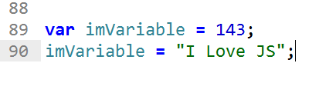
Variables
String
Before continuing, you will notice that so far I’ve set all the variables as nondecimal numbers. In JavaScript (and all programming languages), there is the notion of types. There are a number of types that a variable can be. The most common are the number type and the string type. There’s also the Boolean type, which can only be set to true or false. When working with JavaScript, you usually won’t have to worry too much about types. Even if a variable is declared with an integer value, it can then be updated to be a string value, as follows:

Slide 19
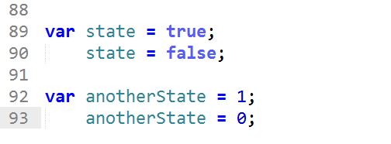
Variables
Boolean
There are situations in your program that you need to save the current state. We save these states in a Boolean variable. These variables are then passed through an if() statement to perform a certain code snippet or function. Most often your states are 1s or 0s and true or false;

Slide 20
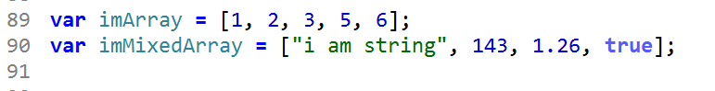
Variables
Arrays
These values can be of any type, and not all values within an array have to be the same type. You can create an array by listing values between square braces, like so:
For now, that’s all you need to know about arrays. I will cover them in more detail before this chapter is over.

Slide 21
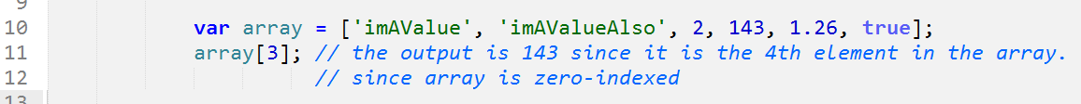
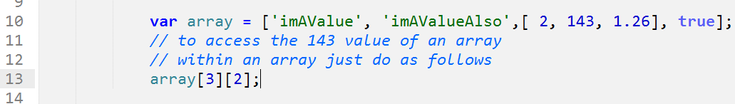
Variables
Arrays
You can access the values of an array as follows:
You can also create an array that has an array as a value. Which means you will have an array within an array or a multi-dimensional array. See the code below:

Slide 22
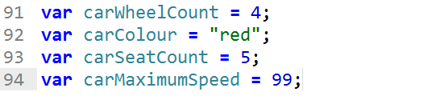
Variables
Objects
The other type, object, is more easily explained with an example. Let’s say you have the concept of a car in your application. This car has a certain number of wheels and seats, is a certain color, and has a maximum speed. You could model this car with four separate variables:

Slide 23
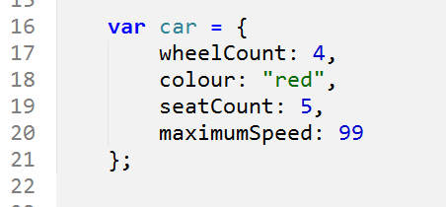
Variables
Objects
It would be easier if you could have just one variable—car—that contained all this information. This is what an object does. It’s a way to store lots of information (that is usually related) within one variable. If I were using objects, the previous code for the car might look something like:

Slide 24
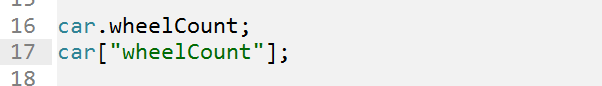
Variables
Objects
The syntax for creating an object is a little different from anything else you’ve seen so far, so let’s walk through it. You create the variable as normal, but then to create an object, you wrap it in curly braces. An object is a set of key-value pairs, also referred to as properties. You create these by listing them in the format key: value, putting a comma at the end of all but the last property. As I hope you can see, this is a much nicer way to model your code programmatically.
To access properties within the object, you have two choices:

Slide 25
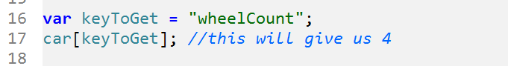
Variables
Objects
The reason for having two ways of accessing properties is easily demonstrated. The vast majority of the time, you will be using the first version, the dot notation. The only time you’ll need to use the second version is if you need to access a key in an object when the name of that key is stored in a variable. This is clearer to see in a demonstration. Let’s say that the key I want to access, wheelCount, is stored in a variable due to some prior code in your application.
If you want to get at the value at wheelCount, you have to use the second notation, as follows:
This situation doesn’t happen a lot, but sometimes you need to use it.

Slide 26
Conditionals
Along with other programming languages JS have a variety of conditionals that you can use in your programs depending on your program. Something you’ll often want to do is run code conditionally. That is, only do something if something else is true or false.
if
if-else
if-else if-else
4. try-catch
ternary operator
switch-case

Slide 27
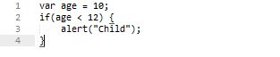
Conditionals
if
For example, alert “child” if the age variable is less than 12. JavaScript has this ability through if statements.

Slide 28
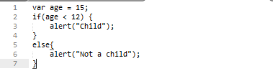
Conditionals
if-else
But what if you wanted to do something else if the age is greater than 12? Along with the if statement, you can attach an else onto the end of that, as follows:

Slide 29
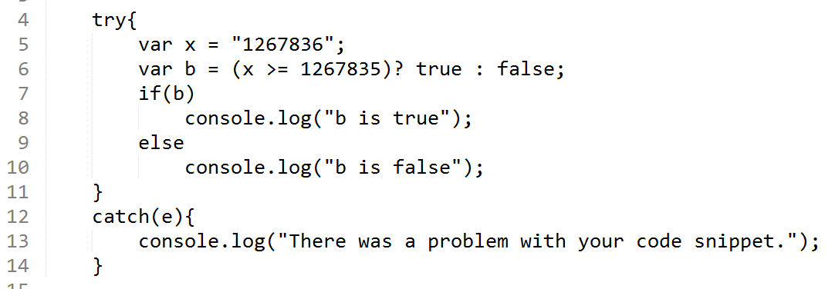
Conditionals
try-catch
The next conditional is try-catch. It is often used to trap errors so it wont mess your program.
The try-catch statement marks a block of statements to try, and specifies a response, should an exception be thrown.

Slide 30
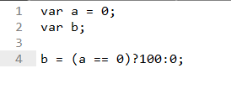
Conditionals
ternary operation
The ternary operator is an operator that takes three arguments. The first argument is a comparison argument, the second is the result upon a true comparison, and the third is the result upon a false comparison. If it helps you can think of the operator as shortened way of writing an if-else statement. It is often used as a way to assign variables based on the result of an comparison. When used correctly it can help increase the readability and reduce the amount of lines in your code.
In our sample code snippet, we assign the value of 100 to variable b if the value of variable a is 0 otherwise the value of b is zero

Slide 31
Comparison operators
You have used some comparison operators with our conditionals. We can discuss it more now. There are
Equality operators
Equality (==)
Inequality (!=)
Identity / strict equality (===)
Not-Identity / strict inequality (!==)
Relational operators
Greater than operator (>)
Greater than or equal operator (>=)
Less than operator (<)
Less than or equal operator (<=)

Slide 32
Comparison operators
Equality (==)
The equality operator converts the operands if they are not of the same type, then applies strict comparison. If both operands are objects, then JavaScript compares internal references which are equal when operands refer to the same object in memory.
Inequality (!=)
The inequality operator returns true if the operands are not equal. If the two operands are not of the same type, JavaScript attempts to convert the operands to an appropriate type for the comparison. If both operands are objects, then JavaScript compares internal references which are not equal when operands refer to different objects in memory.
Identity / strict equality (===)
The identity operator returns true if the operands are strictly equal (see above) with no type conversion.

Slide 33
Comparison operators cont’
Non-identity / strict inequality (!==)
The non-identity operator returns true if the operands are not equal and/or not of the same type.
Greater than operator (>)
The greater than operator returns true if the left operand is greater than the right operand.
Greater than or equal operator (>=)
The greater than operator returns true if the left operand is greater than the right operand.
Less than operator (<)
The less than operator returns true if the left operand is less than the right operand.
Less than or equal operator (<=)
The less than or equal operator returns true if the left operand is less than or equal to the right operand.

Slide 34
Logical operators
Logical operators are typically used with Boolean (logical) values. When they are, they return a Boolean value. However, the && and || operators actually return the value of one of the specified operands, so if these operators are used with non-Boolean values, they may return a non-Boolean value.
Logical Operators are:
AND (&&)
OR (||)
NOT (!)

Slide 35
Loops
JavaScript performs several types of repetitive operations, called "looping". Loops are set of instructions used to repeat the same block of code till a specified condition returns false or true depending on how you need it. To control the loops you can use counter variable that increments or decrements with each repetition of the loop.
JavaScript supports two loop statements: for and while. The For statements are best used when you want to perform a loop a specific number of times. The While statements are best used to perform a loop an undetermined number of times. In addition, you can use the break and continue statements within loop statements.

Slide 36
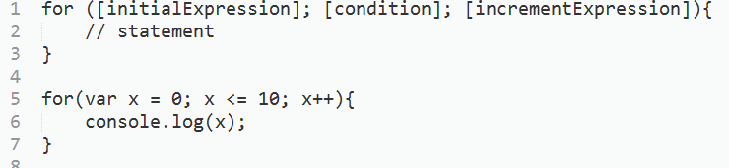
Loops
for loop
A for loop repeats until a specified condition evaluates to false. The JavaScript for loop is similar to the Java and C for loop. A for statement looks as follows:

Slide 37
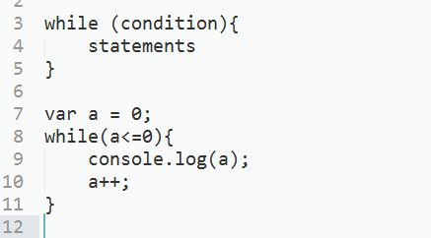
Loops
while loop
A while statement executes its statements as long as a specified condition evaluates to true. A while statement looks as follows:
If the condition becomes false, statement within the loop stops executing and control passes to the statement following the loop.
The condition test occurs before statement in the loop is executed. If the condition returns true, statement is executed and the condition is tested again. If the condition returns false, execution stops and control is passed to the statement following while.
To execute multiple statements, use a block statement ({ ... }) to group those statements.

Slide 38
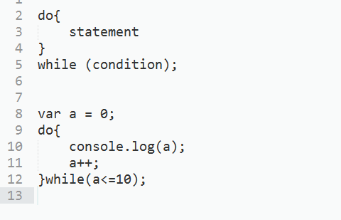
Loops
do-while loop
The do...while statement repeats until a specified condition evaluates to false. A do...while statement looks as follows:

Slide 39
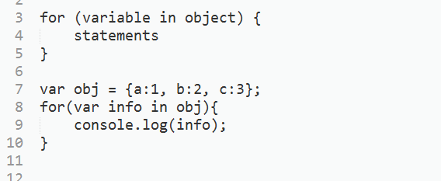
Loops
for-in loop
The for...in statement iterates a specified variable over all the enumerable properties of an object. For each distinct property, JavaScript executes the specified statements. A for...in statement looks as follows:

Slide 40
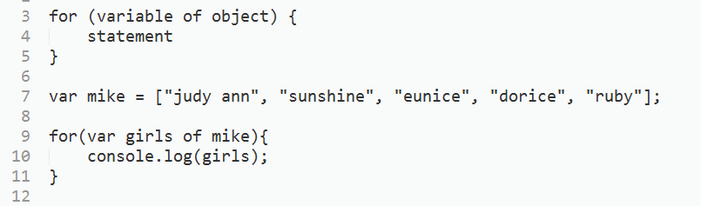
Loops
for-of loop
The for...of statement creates a loop Iterating over iterable objects (including Array, Map, Set, arguments object and so on), invoking a custom iteration hook with statements to be executed for the value of each distinct property.
The following example shows the difference between a for...of loop and a for...in loop. While for...in iterates over property names, for...of iterates over property values.

Slide 41
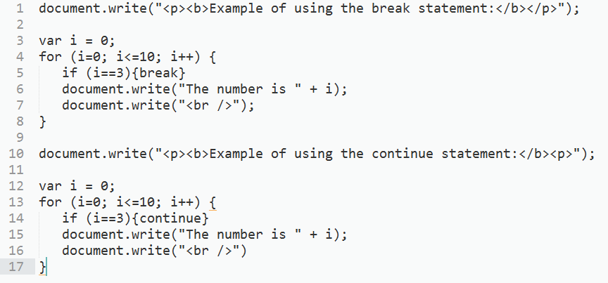
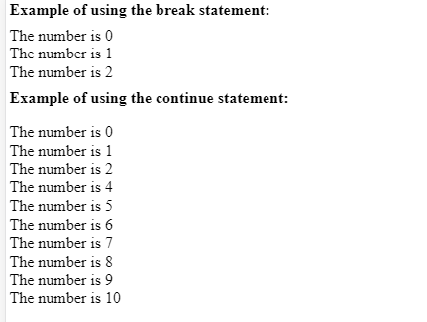
Loops
Break and Continue Statements
Sometimes you may want to let the loops start without any condition, and allow the statements inside the brackets to decide when to exit the loop. There are two special statements that can be used inside loops: break and continue. The break statement terminates the current while or for loop and continues executing the code that follows after the loop (if any). A continue statement terminates execution of the block of statements in a while or for loop and continues execution of the loop with the next iteration.

Slide 42
Functions
Functions are one of the fundamental building blocks in JavaScript. A function is a JavaScript procedure—a set of statements that performs a task or calculates a value. To use a function, you must define it somewhere in the scope from which you wish to call it.
A function definition (also called a function declaration, or function statement) consists of the function keyword, followed by:
The name of the function.
A list of parameters to the function, enclosed in parentheses and separated by commas.
The JavaScript statements that define the function, enclosed in curly brackets, { }.

Slide 43
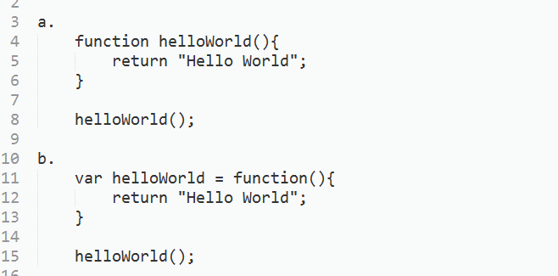
Functions
Named function
One can define "named" function expressions (where the name of the expression might be used in the call stack for example).

Slide 44
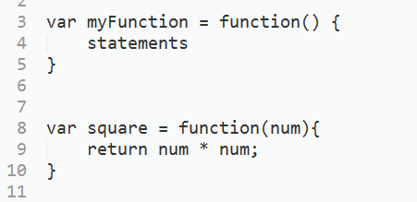
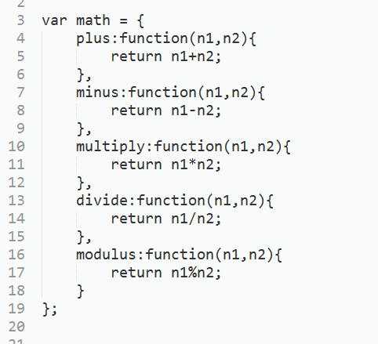
Functions
Anonymous function
Anonymous functions are functions that doesn’t have a name.

Slide 45
Resources:
http://www.dnawebagency.com/ternary-operator/
https://developer.mozilla.org/en-US/docs/Web/JavaScript/Reference/Statements/try...catch
https://developer.mozilla.org/en-US/docs/Web/JavaScript/Reference/Operators/Comparison_Operators

